Slide 1
Data Star Graph Theory
Trainer: Tan Yee Sern

Slide 2
What are graphs
A graph G consists of:
A set of vertices V (also called nodes)
And a set of edges E (also called links)
Where each edge connects between two vertices
v₁
v₅
e₇
This graph consists of:
Vertices = { v₁, v₂, v₃, v₄, v₅ }
Edges = { e₁, e₂, e₃, e₄, e₅, e₆, e₇ }
Where e₁ = ( v₁, v₂ ), e₂ = ( v₁, v₃ ), e₃ = ( v₁, v₄ ), e₄ = ( v₂, v₄ ), e₅ = ( v₃, v₄ ), e₆ = ( v₂, v₃ ), e₇ = ( v₁, v₅ )
e₃
e₁
e₂
e₄
v₄
e₅
v₂
v₃
e₆

Slide 3
Directed Graphs
Graphs can be directed
The edges of directed graphs have directions
Graphs can also be bi-directed
Here V = { v₁, v₂, v₃, v₄ }
E = { e₁, e₂, e₃, e₄ }
Where e₁ = ( v₁, v₂ ), e₂ = ( v₂, v₁ ), e₃ = ( v₃, v₂ ), e₄ = ( v₄, v₂ )
Notice the direction of the tuples
v₃
e₃
v₁
e₁
e₂
v₂
e₄
Edges can represent the direction of flow
v₄

Slide 4
Weighted Graphs
Graphs can also be weighted
The edges of a weighted graph have weights
Weights can represent various measures, such as importance, cost, and strength of connection
5
2
10
2
3
5
2

Slide 5
Examples
Complete graph: every vertex is adjacent to every other vertex
The most edge-populated graph possible
Simple cycle: a path that starts and ends at the same vertex, does not repeat any other vertex or any edge
Tree: a graph with no cycles
Spanning tree is a connected tree
Minimum Spanning Tree problem can be solved with Kruskal’s or Prim’s algorithm
Star graph: hub and spoke model

Slide 6
Bipartite Graphs
Some graphs are bipartite
Bipartite graphs have vertices partitioned into two parts
There are no edges within the same part
Bipartite graphs can be applied for “matchmaking”
Graph matching
The two parts can be:
Different genders
Customers and products (links representing purchases)
Objects and properties (links meaning objects have property)

Slide 7
Graphs in the Real World
Graphs in real world can be studied as complex systems
The study of complex networks is called Network Science
The number of possible graphs grow super-exponentially with the number of vertices!
Common types of real-world networks include:
Information technology networks
Semantic networks
Utilities and transportation networks
Social networks
Biological networks

Slide 8
Examples

Slide 9
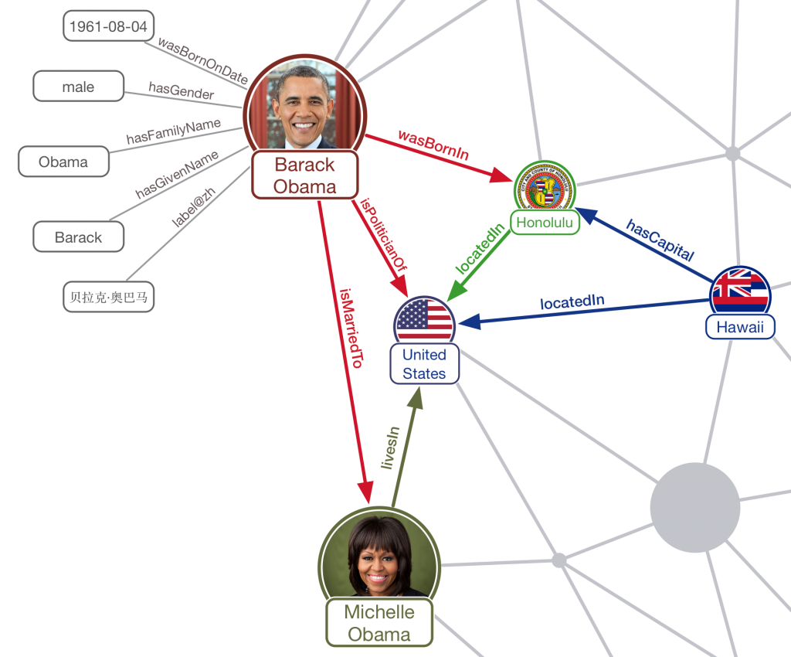
Knowledge
Graph
Source: Ambiverse
https://www.ambiverse.com/knowledge-graphs-encyclopaedias-for-machines/

Slide 10
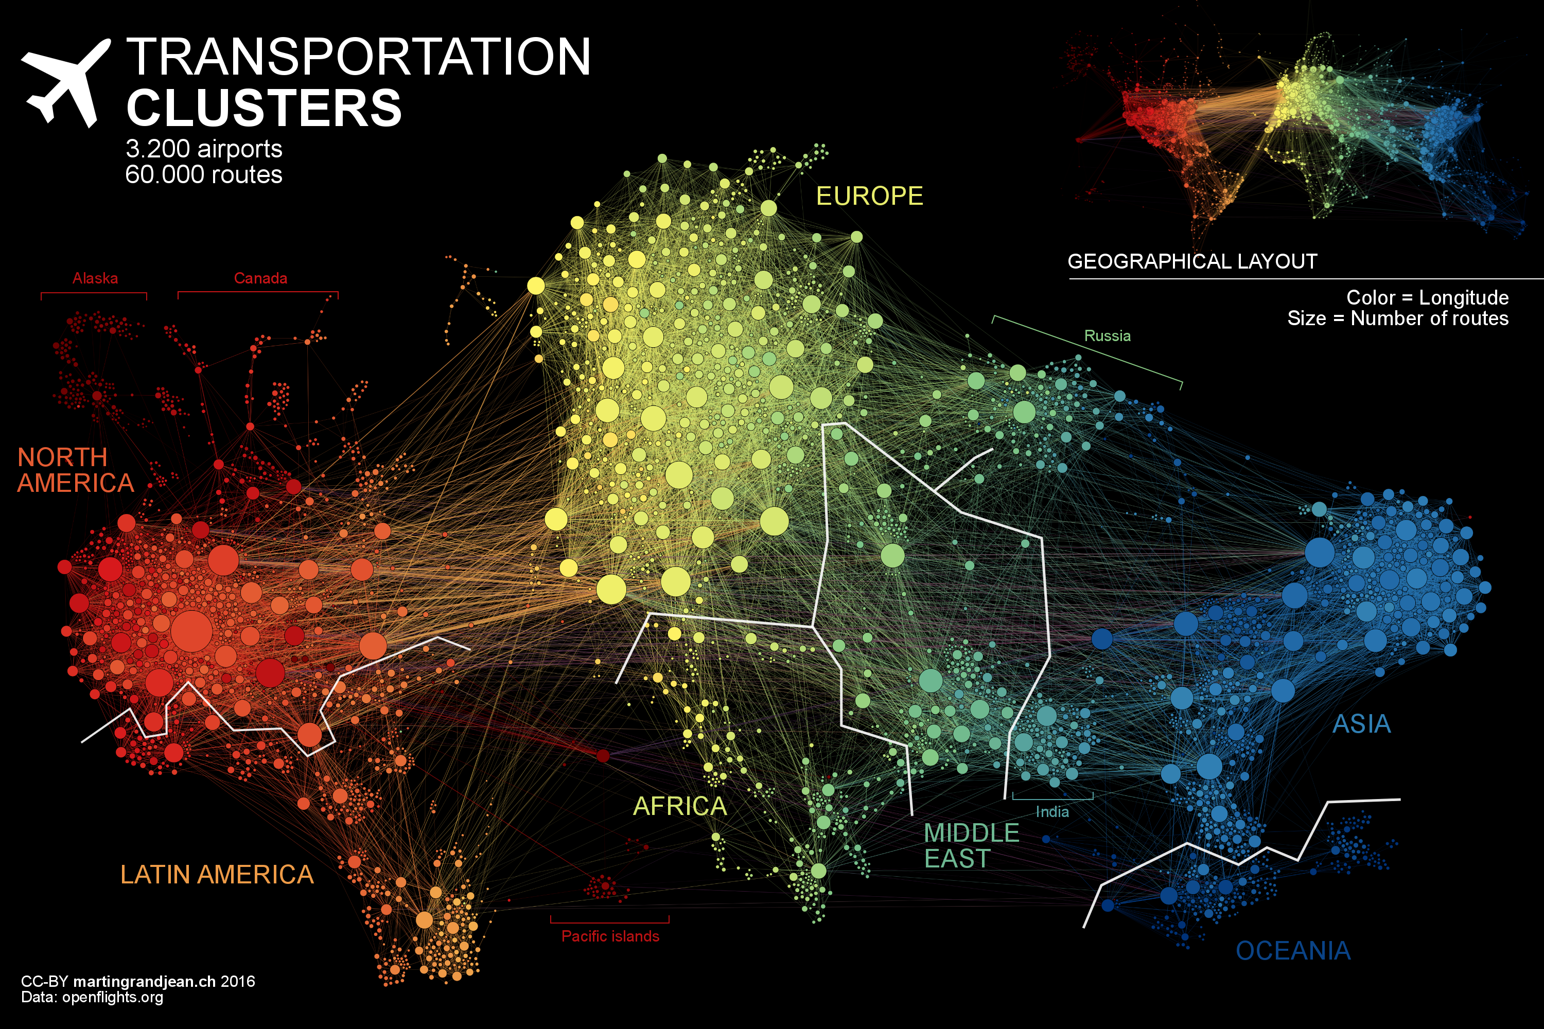
Global Flight Network
(Locations are only approximate as they are subject to the layout of node sizes)
Source: www.martingrandjean.ch

Slide 11
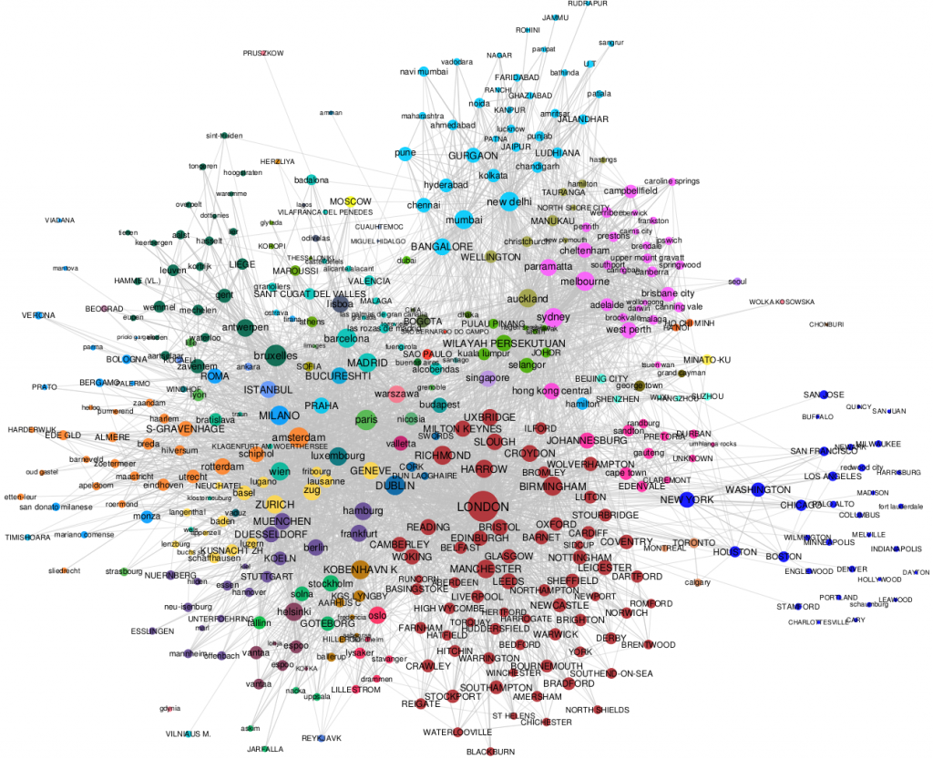
Global Network of Corporate Interlocks (based on cities)
Source: London School of Economics blog
http://blogs.lse.ac.uk/businessreview/2016/07/15/network-science-shows-london-is-at-the-heart-of-the-worlds-corporate-elite/

Slide 12
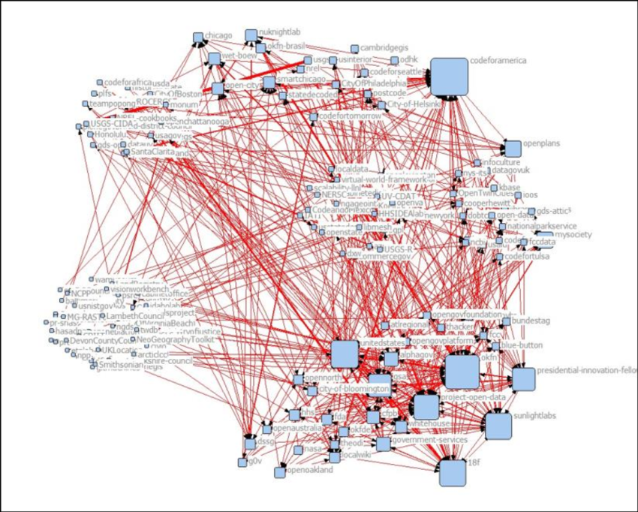
Collaboration Network among Government Github Community
For Malaysia:
www.data.gov.my is a public site for open government data
Source: ResearchGate
https://www.researchgate.net/publication/265686164_Introducing_Open_Collaboration_in_the_Public_Sector_The_Case_of_Social_Coding_on_Github

Slide 13
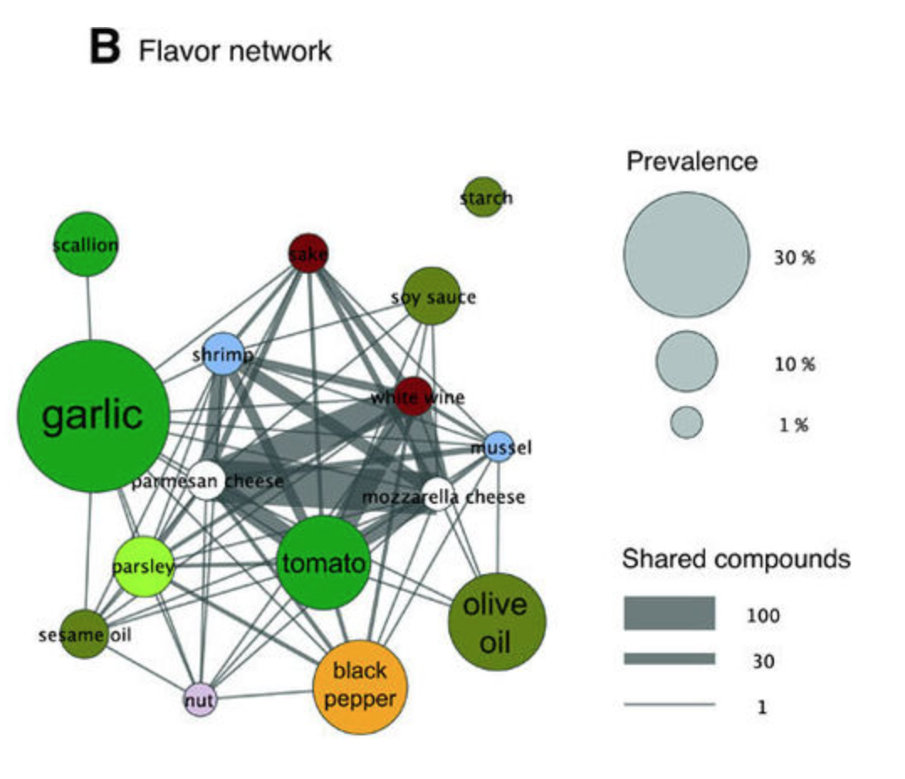
Flavor Network and Food Pairing
Source: Nature Scientific Reports
https://www.nature.com/articles/srep00196/figures/1

Slide 14
Graph Analytics

Slide 15
Degree of Vertices
The degree of a vertex in a graph is the number of adjacent vertices
v₁
v₅
The degree of v₁ here is 4
It is adjacent to v₂, v₃, v₄, v₅
The degree of v₂ here is 3
It is adjacent to v₁, v₃, v₄
The degree of v₅ here is 1
It is adjacent to v₁
e₇
e₃
e₁
e₂
e₄
v₄
e₅
v₂
v₃
e₆

Slide 16
Degree of Vertices: Directed Graph
The degree in directed graphs can be divided into:
In-degree: The number of edges pointing into a vertex
Out-degree: The number of edges pointing out from a vertex
The in-degree of v₂ here is 3
It is incident to incoming edges e₁, e₃, e₄
The out-degree of v₂ here is 1
It is incident to outgoing edges e₂
v₃
e₃
v₁
e₁
e₂
v₂
e₄
v₄

Slide 17
Degree of Vertices: Weighted Graph
The degree of a vertex in a weighted graph is the sum of the weights of its incident edges
v₃
v₅
The degree of v₁ here is 10 + 5 + 5 = 20
The degree of v₂ here is 10 + 2 + 2 = 14
The degree of v₃ here is 3 + 5 = 8
The degree of v₅ here is 2 + 2 = 4
5
2
10
2
3
v₁
v₂
5
2
v₄
v₆

Slide 18
Shortest Path Length
The shortest path length from vertex v to vertex u is the minimum number of edges to get from v to u
v₃
v₂
e₂
e₃
v₄
e₁
e₄
The shortest path length from v₁ to v₅ is 1 because there is an edge e₉ between them.
The shortest path from v₁ to v₃ is 2, via e₁ and e₂ .
The shortest path from v₁ to v₄ is 2,
via e₉ and e₄ .
e₉
v₁
v₅
e₈
e₅
v₈
e₇
e₆
v₆
v₇

Slide 19
Shortest Path Length
The shortest path in a weighted graph is the minimum of sum of weights among paths from v to u.
When navigating from a location to another location in a city via roads, how would you choose the route?
The network of roads in a city will be needed.
The intersection of roads are vertices.
Individual road segments are edges.
Each edge has a weight associated. This can be distance to travel, time to travel, or a hybrid of both.
Dijkstra’s algorithm can be used to compute the shortest path.

Slide 20
Six Degrees of Separation
https://www.youtube.com/watch?v=TcxZSmzPw8k
How many degrees of separation?
This is actually not a simple question

Slide 21
Clustering Coefficient
Open and closed triplets
The clustering coefficient of vertex v is defined as: Number of closed triplets / Total number of triplets
Open triplet
Closed triplet
v₃
The open triplets of vertex v₁ are: (v₁, v₂, v₃), (v₁, v₂, v₄)
The close triplets of vertex v₁ are: (v₁, v₃, v₄)
The clustering coefficient of v₁ is: 1/(2+1) = 1/3
v₂
v₄
v₁

Slide 22
Strength of Weak Ties
Closed triplets are also called strong ties
Open triplets are also called weak ties
In a friendship network, when you have a closed triplet, your friend of a friend is also a friend of yours
When many of the ties are strong ties, you will not be able to reach as many people in the same number of steps
https://research.fb.com/how-strong-and-weak-ties-help-you-find-a-job/
Research shows that strong ties help people maintain close relationships, while weak ties help people advance careers and professional connections

Slide 23
Spreading Behavior
What things spread on a network?
Social network
Rumors
Sentiments
Information technology network
Knowledge
Computer viruses
Biology network
Diseases

Slide 24
Centralities
Who is more central in the phenomena of spreading?
Effectiveness in reaching out to people
Knows most of the gossip going around in the office
Bridging people from different communities
Most likely to be noticed by any random person

Slide 25
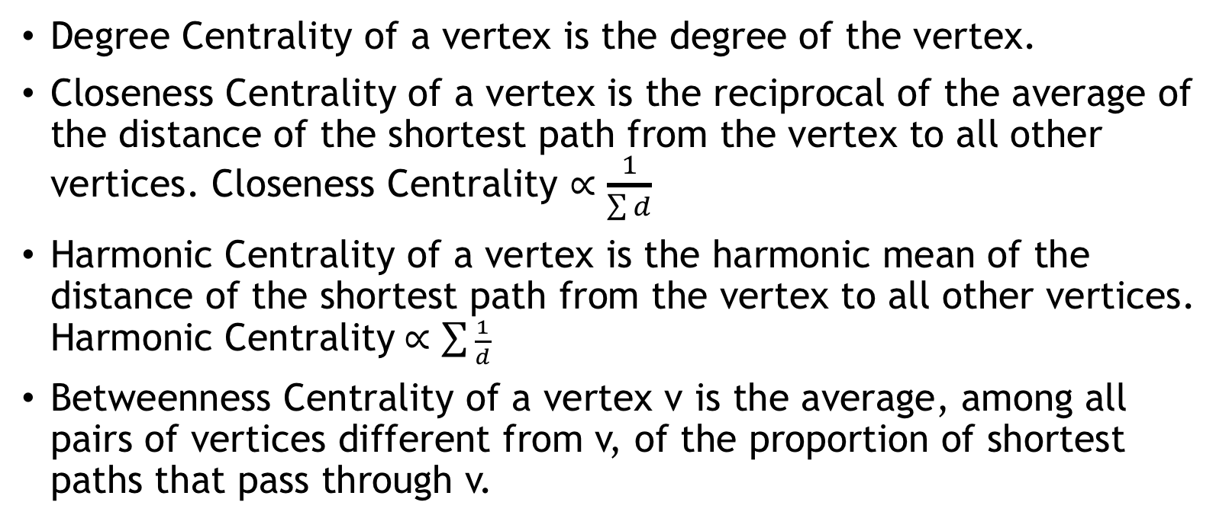
Centralities
Degree Centrality of a vertex is the degree of the vertex.
Closeness Centrality of a vertex is the reciprocal of the average of the distance of the shortest path from the vertex to all other vertices. Closeness Centrality $∝\frac{1}{\sum{d}}$
Harmonic Centrality of a vertex is the harmonic mean of the distance of the shortest path from the vertex to all other vertices. Harmonic Centrality$∝\sum{\frac{1}{d}}$
Betweenness Centrality of a vertex v is the average, among all pairs of vertices different from v, of the proportion of shortest paths that pass through v.

Slide 26
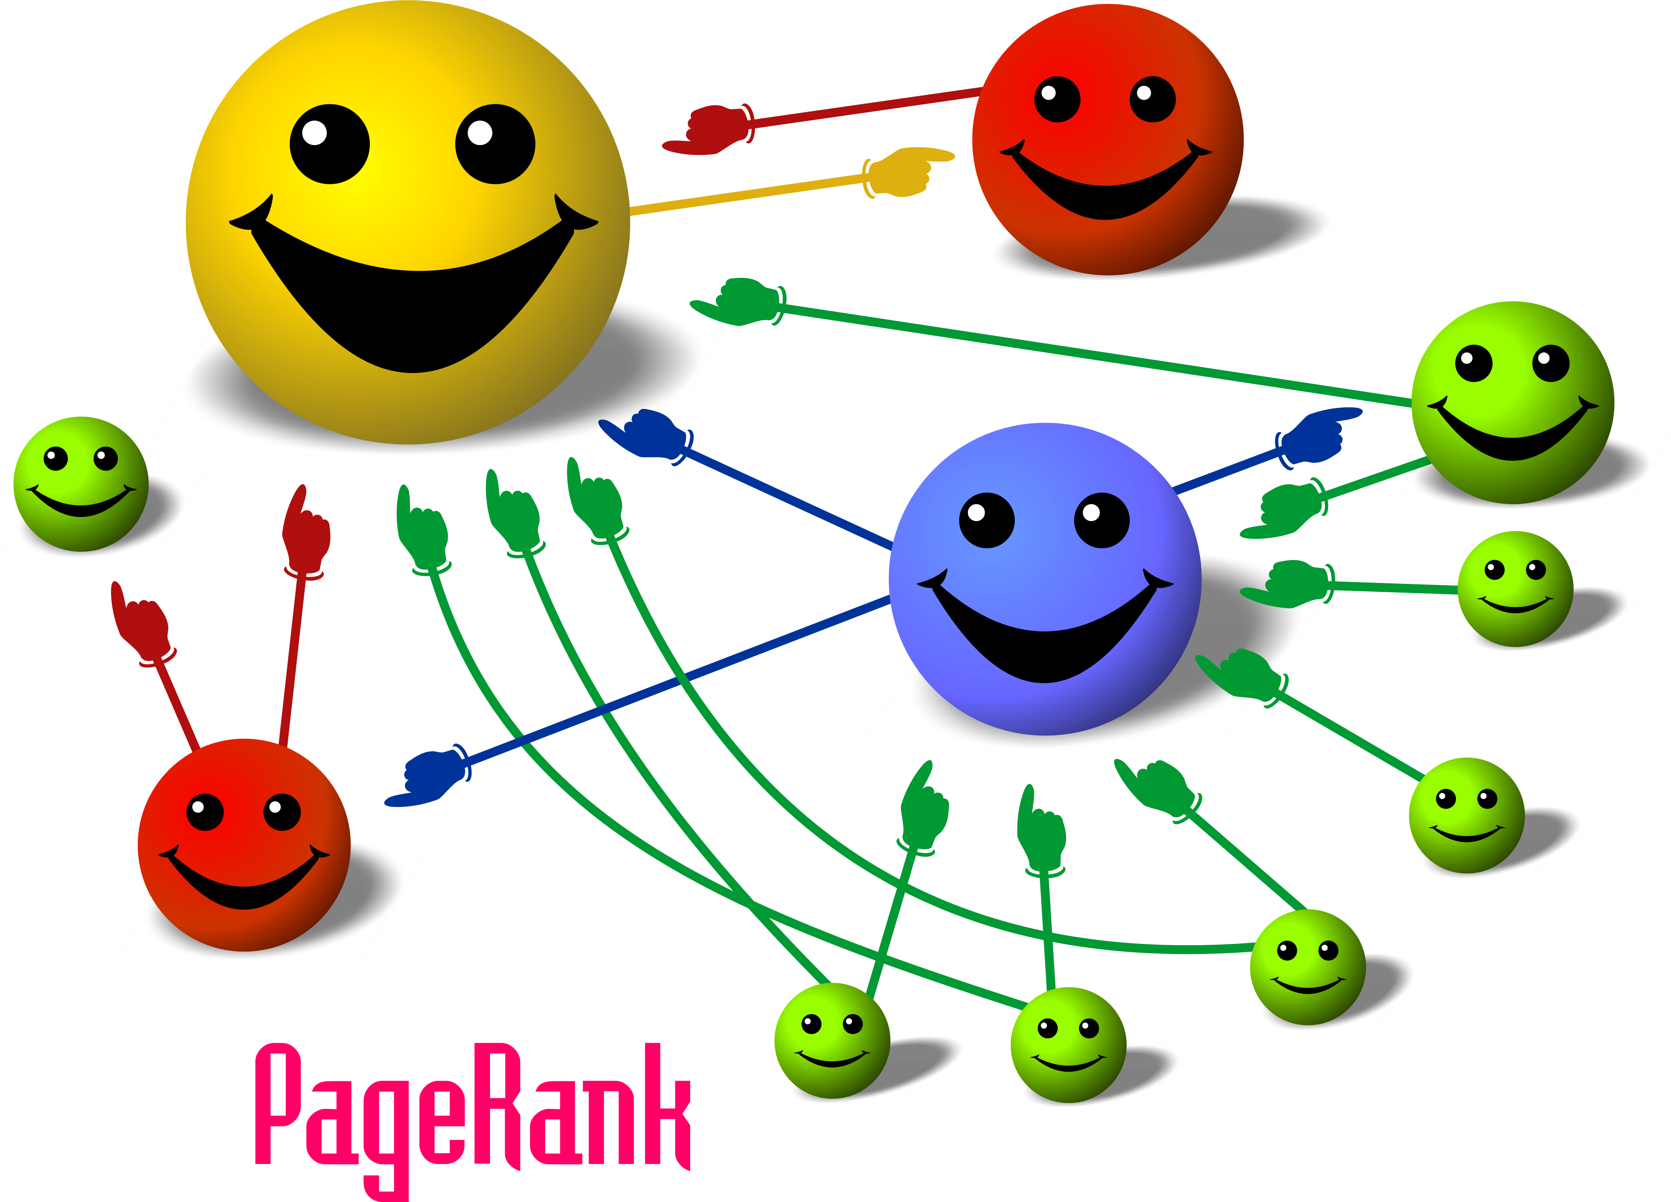

Slide 27
PageRank
PageRank Centrality is closely related to Google’s PageRank
Eigenvector Centrality is the equilibrium state of this process:
Initialize a centrality metric for each vertex
In each iteration, for each vertex, distribute its centrality evenly among all outgoing edges.
The centrality of the next iteration is equal to the sum of incoming centralities
Repeat until convergence
PageRank Centrality, in addition to Eigenvector Centrality, uses random teleportation with a small probability, to avoid some vertices from being zeroed out
Typically few nodes will have very high PageRank Centrality, and the rest will be close to zero

Slide 28
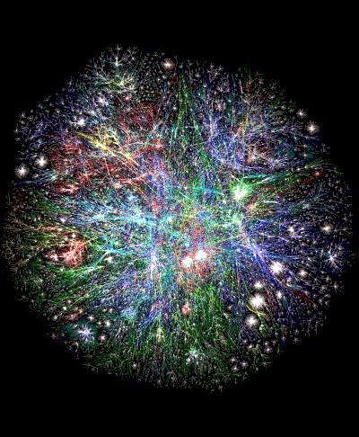
Preferential Attachment
3D Map of the World Wide Web
Source:
http://www.vlib.us/web/worldwideweb3d.html

Slide 29
Preferential Attachment
Preferential attachment explains why many graphs are scale-free graphs
Scale-free means that the degree distribution follows a power-law with no scale
The result is that many graphs grow into having few nodes with very large degree, and many nodes to have small degree
http://estebanmoro.org/2012/11/preferential-attachment-be-first/
The preferential attachment process starts from a small graph. Vertices are added sequentially with fixed number of edges. Each edge is attached to pre-existing vertices with a probability proportional to the degree of those vertices.
Think: if you have n friends, your probability of growing in the network is proportional to n
“The rich get richer”

Slide 30
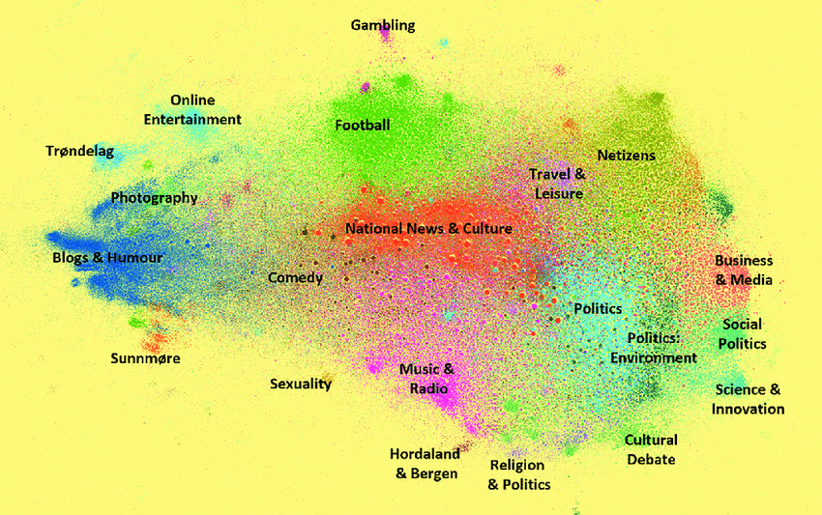
Communities
Norwegian Twittersphere Network
Source: https://www.researchgate.net/publication/322978321_Norwegian_Twittersphere_Dynamics_and_Structure

Slide 31
Communities
Communities are subsets of the network that are more frequently connected to itself than to other parts
Community structure is present in many real-world networks
Community detection can suggest communities present in the network. It works at different levels of granularity. Sometimes, coarse communities themselves can contain finer subcommunities.
Community structure increases the average shortest path length, making the network less efficient at transmitting to other parts

Slide 32
Communities
Popular community detection algorithms include (for reference):
Girvan-Newman algorithm
Louvain algorithm
Infomap algorithm

Slide 33
Data Structures

Slide 34
Data Structures: Adjacency List
Many real-world networks are sparse (average degree is much lesser than total number of vertices)
They are best stored as adjacency lists:
list of neighbors of each vertex
v₁
v₅
Adjacency List
v₁ | 2, 3, 4, 5
v₂ | 1, 3, 4
v₃ | 1, 2, 4
v₄ | 1, 2, 3
v₅ | 1
e₇
e₃
e₁
e₂
e₄
v₄
e₅
v₂
v₃
e₆

Slide 35
Data Structures: Adjacency Matrix
The adjacency matrix is a matrix of 0’s and 1’s
The rows and columns are indexed by vertices
The entry of i-th row and j-th column is:
1 if there is an edge going from vertex i to vertex j
0 otherwise
v₁
v₅
Adjacency Matrix
 | v₁ | v₂ | v₃ | v₄ | v₅
v₁ | 0 | 1 | 1 | 1 | 1
v₂ | 1 | 0 | 1 | 1 | 0
v₃ | 1 | 1 | 0 | 1 | 0
v₄ | 1 | 1 | 1 | 0 | 0
v₅ | 1 | 0 | 0 | 0 | 0
e₇
e₃
e₁
e₂
e₄
v₄
e₅
v₂
v₃
e₆

Slide 36
Technologies

Slide 37
Graph Storage
Graph database: Neo4j (popular and open source)
Avoids the costly operation of joins in relational databases
RDF store or triple store: AllegroGraph (popular)
Graph query languages: Cypher, SPARQL, Gremlin

Slide 38
Neo4j
Neo4j can be downloaded here, and with installation instructions
Neo4j YouTube channel link

Slide 39
Cypher
An introduction to Cypher (query language for Neo4j) is available here
In Cypher, vertices are called “Nodes” and edges are called “Relationships”
Nodes can have labels and properties
Relationships can have properties
Path lengths can also be specified
The examples provided in the following slides are from: https://neo4j.com/docs/developer-manual/current/cypher/

Slide 40
Cypher Queries
Command MATCH is analogous to SELECT in SQL but a pattern must be specified
Example: to return all the names of actors who acted in the movie Wall Street
MATCH (wallstreet:Movie { title: 'Wall Street’ }) <-[:ACTED_IN]-(actor) RETURN actor.name
Example: to return the roles of actors who acted in the movie Wall Street
MATCH (wallstreet { title: 'Wall Street’ }) <-[r:ACTED_IN]-(actor) RETURN r.role

Slide 41
Cypher Queries
CREATE in Cypher is analogous to the same name command in SQL
Example: to create a person with name Andres and title Developer
CREATE (n:Person { name: 'Andres', title: 'Developer’ })
Example: to create a relationship
MATCH (a:Person),(b:Person) WHERE a.name = 'Node A' AND b.name = 'Node B’ CREATE (a)-[r:RELTYPE]->(b)

Slide 42
Cypher Queries
DELETE is analogous to the same command name in SQL
Example: deletes all the persons with name “UNKNOWN”
MATCH (n:Person { name: 'UNKNOWN' }) DELETE n
Example: deletes all the relationship of “KNOWS” for those who know Andres
MATCH (n { name: 'Andres' })-[r:KNOWS]->() DELETE r

Slide 43
Cypher Queries
SET is analogous to UPDATE in SQL
Example: to set the surname property of all persons with name Andres to be Taylor
MATCH (n { name: 'Andres' }) SET n.surname = 'Taylor’
Example: to set the label German on all persons with name Stefan
MATCH (n { name: 'Stefan' }) SET n:German

Slide 44
Neo4j Online
You can have free renewable access to an application sandbox after registering through https://neo4j.com/sandbox-v2/
The sandbox offers tutorials and examples to master Neo4j using a browser interface

Slide 45
Graph Processing
Apache Giraph (distributed processing of large graphs)
Spark GraphX (distributed processing of large graphs, applies Google’s Pregel programming model)
Python NetworkX library (single cluster)

Slide 46
Graph Visualization
Gephi (free)
Allows the visualization of networks
Provide visual layouts of networks
Size and color vertices and edges according to measures such as centrality
Partition vertices according to their communities
To run large graphs on your computer the requirements are at https://gephi.org/users/requirements/
Software available for free at https://gephi.org/

